Slide 1
Developing an experimental platform for Human Robot Interaction based on human motions
Praveenkumar VASUDEVAN
European Master in Advanced RObotics
Supervisors : Gentiane VENTURE, Associate Professor, TUAT
Yannick AOUSTIN, Maître de Conférence à l'Université de Nantes
Co-supervisor : Armando TACCHELLA, Associate Professor, University of Genoa
2015/04/20

Slide 2
Human Robot Interaction (HRI) and Social Robots
[Dautenhahn, 2007]
A Social robot should have the ability to interact with humans by adhering to certain social cues and rules. [Yan et al, 2014]
Engineering
Social
Science
Robotics
Psychology
Human
Robot
Interaction
Cognitive
Science
Artificial
Intelligence
Human Computer Interaction
Computer
Science

Slide 3
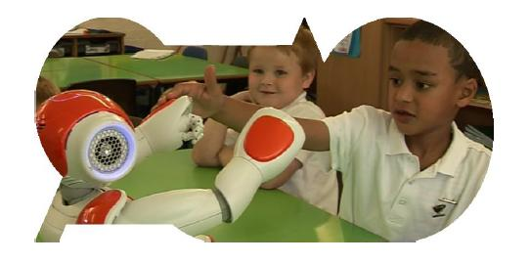
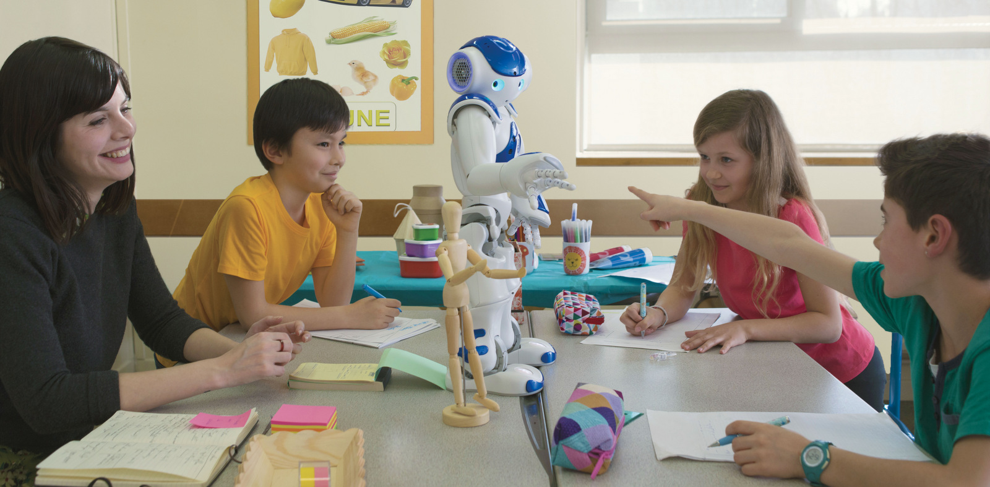
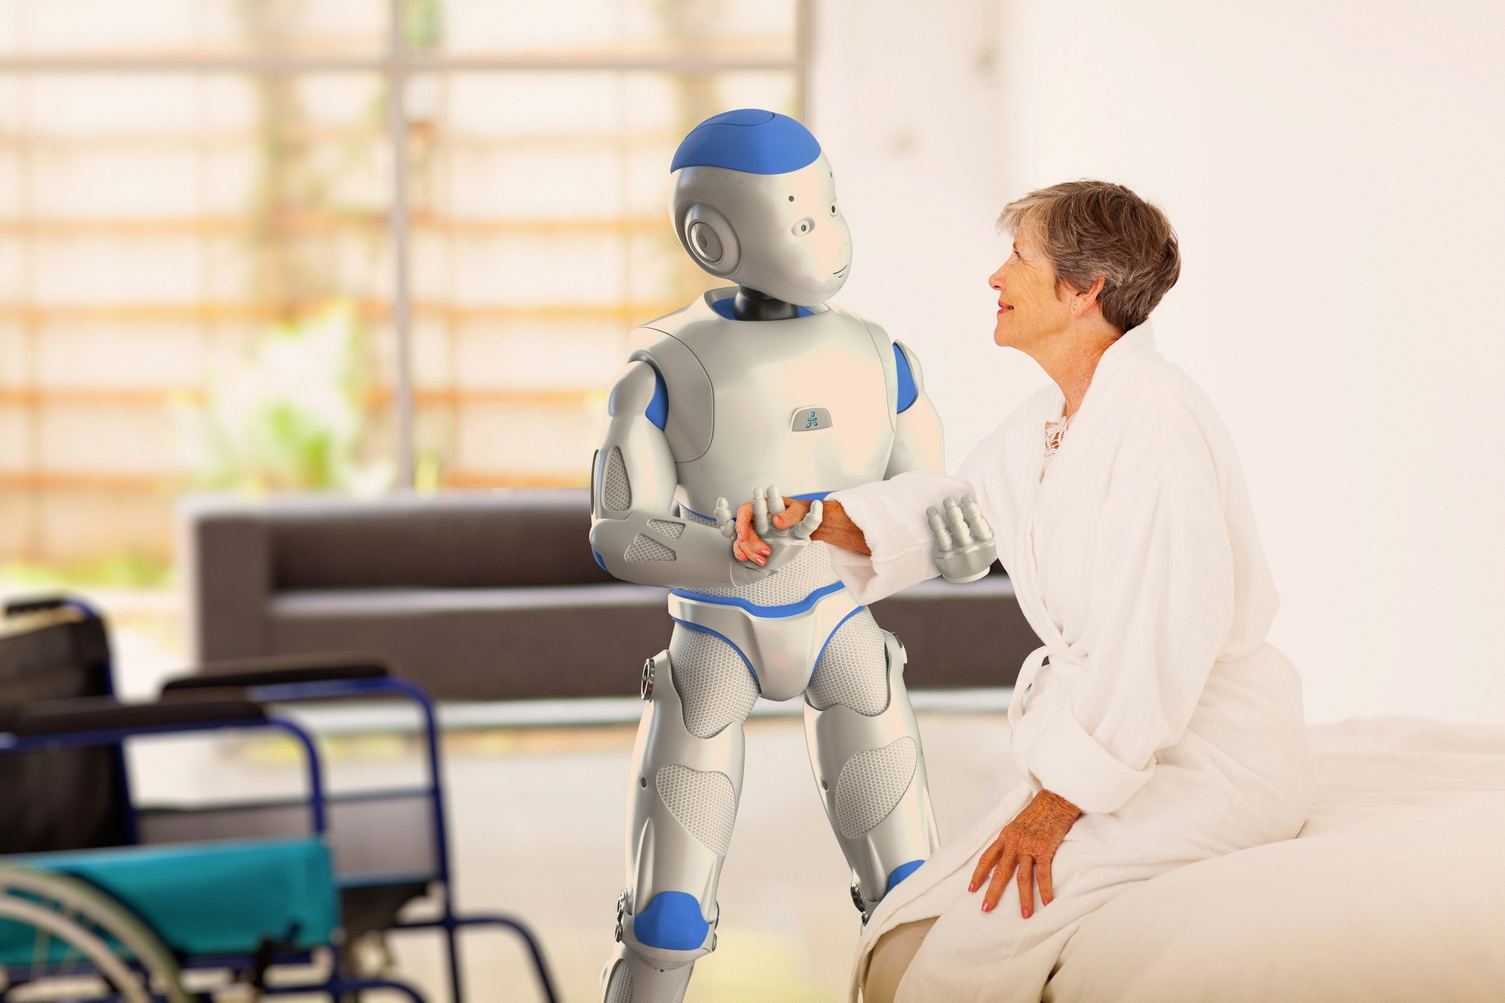
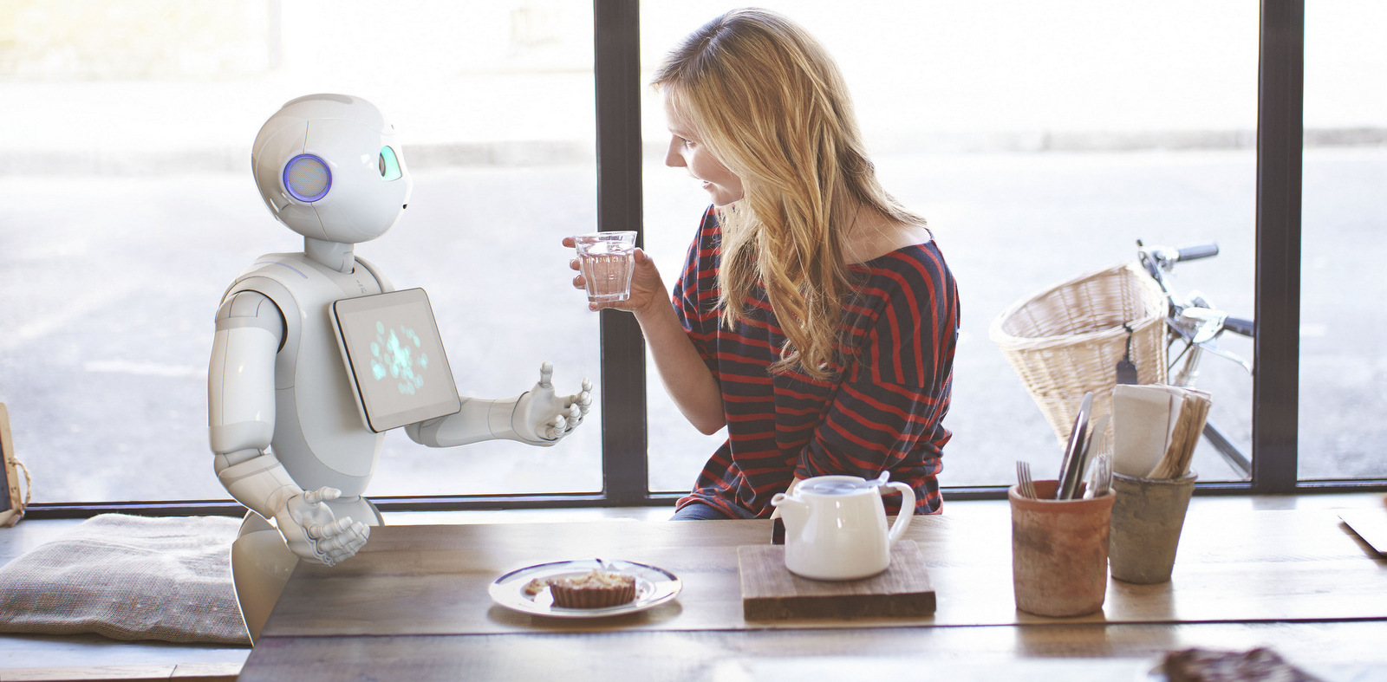
Where is HRI now?
ASKNao (Autism Solution)
Nao in Education
Romeo - Physical Interaction
Juliette (Pepper) - Casual interaction
Images from Aldebaran (https://www.aldebaran.com/en)

Slide 4
Motivation(s)
Humans interacting with intelligent Robots has been seen as a potential game changer in the future.
Human motion (Non-verbal communication) is rich in information and understanding it is very important to improve the interaction.
Motion conveys intention, health, emotion etc.,
Existing tools for designing HRI scenarios and robot behaviors are not scalable and requires skilled roboticists’ assistance
Goal : To develop an experimental platform which
Facilitates interaction based on human motion
Is easy to use by a common user to design and execute interaction scenarios

Slide 5
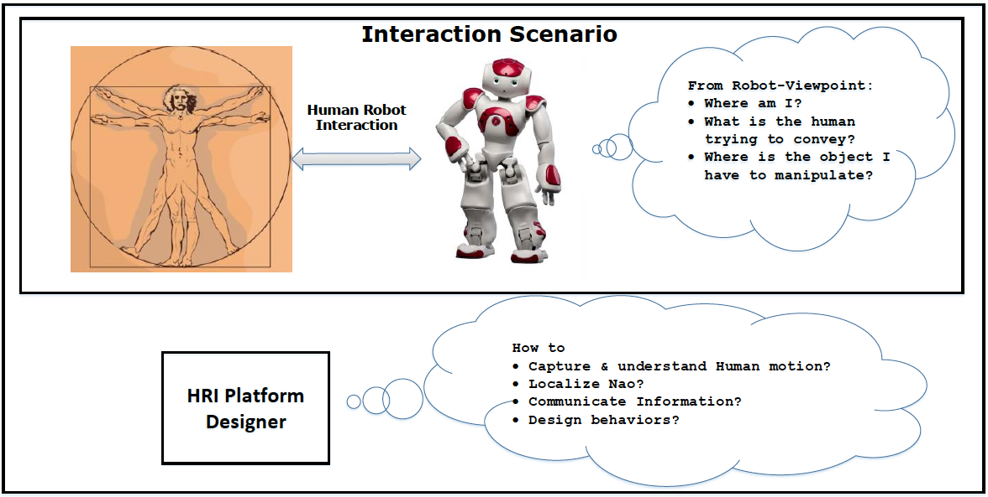
Problem Statement(s)

Slide 6
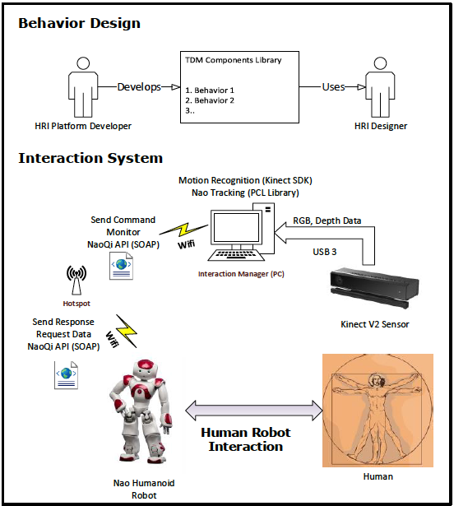
Summary on Bibliographic study
Motion capture:
Stereophotogrammetric system, Monocular Cameras, IMU, RGB-D Cameras (Kinect V2)
Localization:
Marker based approaches, Point cloud library algorithms (Monte carlo localization)
Designing behaviors:
ROS, Choregraphe, Task Description Language, URBI, Microsoft Robotics Developer studio, Target Drives Means?
Evaluation techniques:
Self-assessment, Interviews, Behavioral measures, Psychophysiolgy measures, Task performance metrics
Initial Proposal

Slide 7

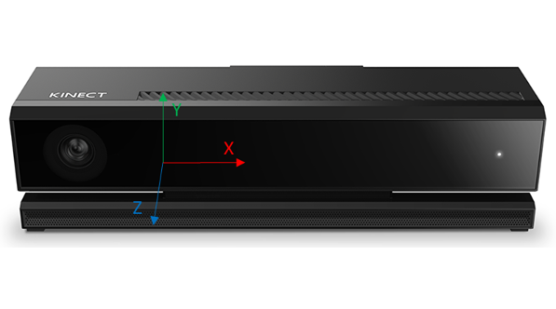
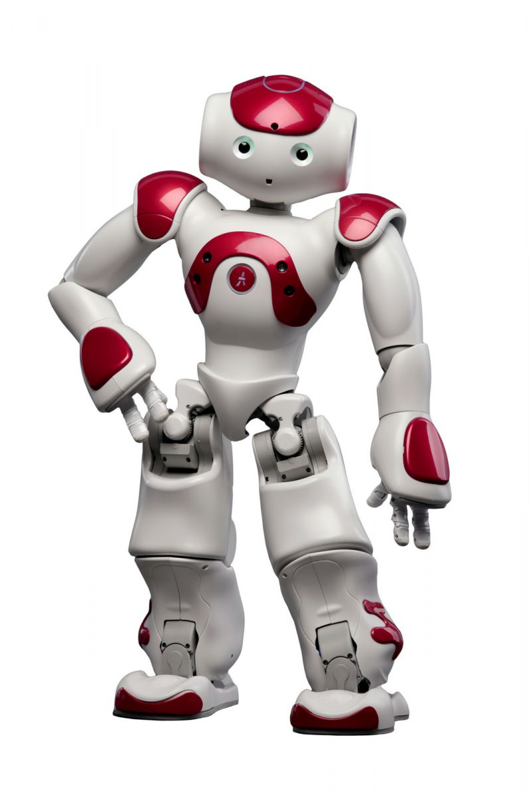
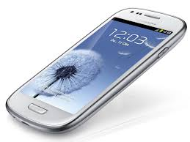
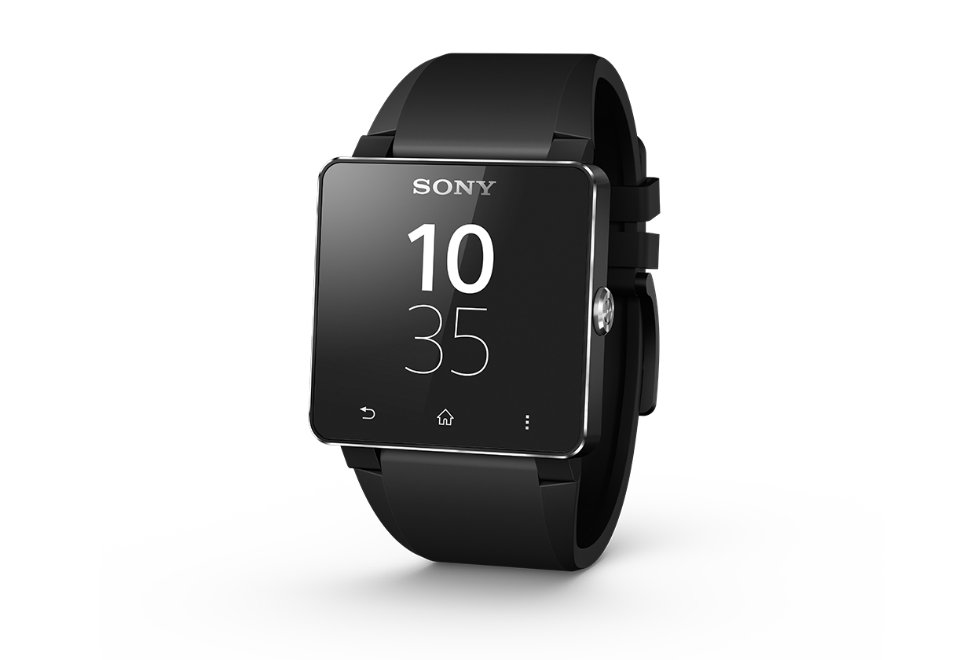
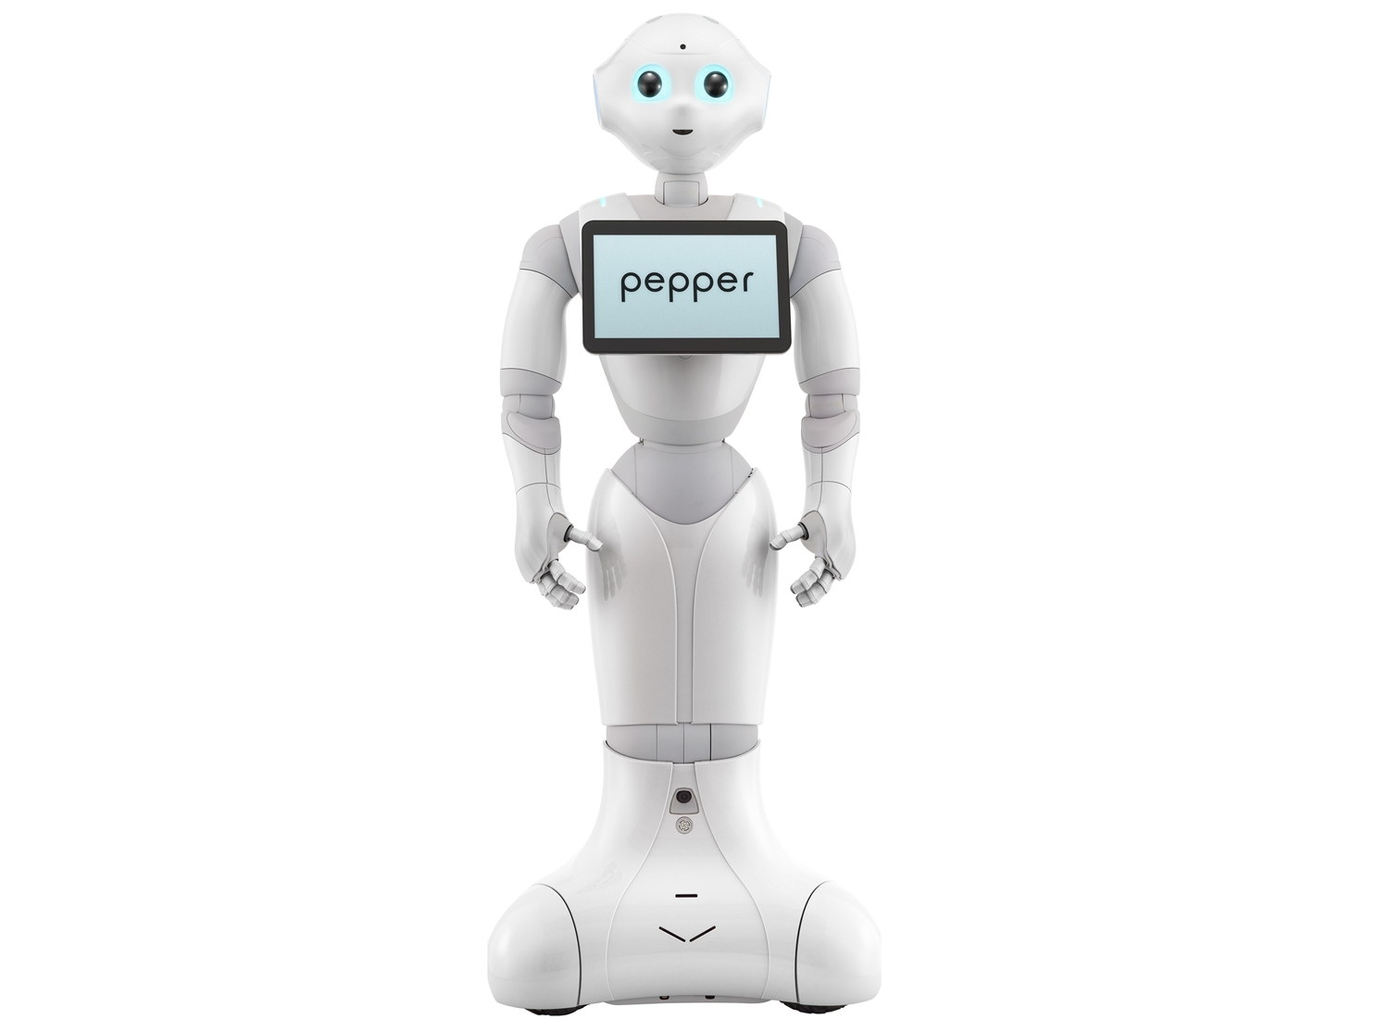
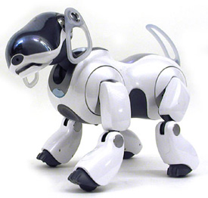
Platform infrastructure design
Goals
Distributed nodes
Achieved using ZeroMQ (TCP, UDP, IPC)
PUB-SUB Protocol, REQ-REP protocol
Transparent messaging protocol that enables good interoperability
Google protocol buffers. Many primitive messages are imported from Gazebo
Visualization capability
OpenRAVE – Open source robotics planning / simulation framework
Visual Programming/ Natural language description of behaviors
Under investigation
Software design concept
Application
Bootstrapper
Configuration File
Nodes
Parameter server
Behavior designer
Behavior Execution engine
Visualization
Motion
recognition
Localization
Robot
interface
Motion
recognition
Localization
Robot
interface
Motion
recognition
Localization
Robot
interface
Robots/ Gadgets

Slide 8
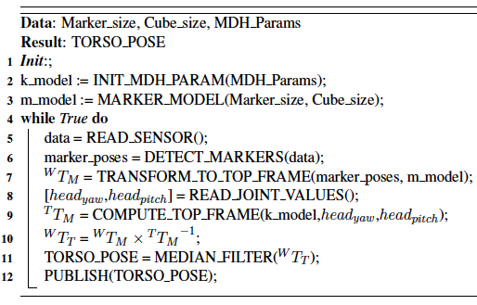

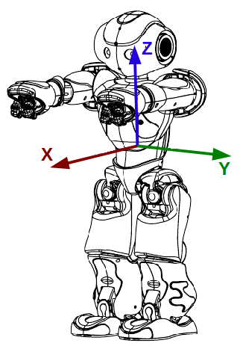
Robot Localization module
System
Algorithm
6D Pose of robot
Localization
TCP
Static link
Robot interface
Kinect Data capture
USB3
Ethernet
Visual Link

Slide 9
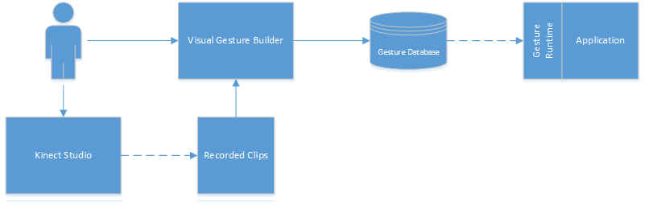
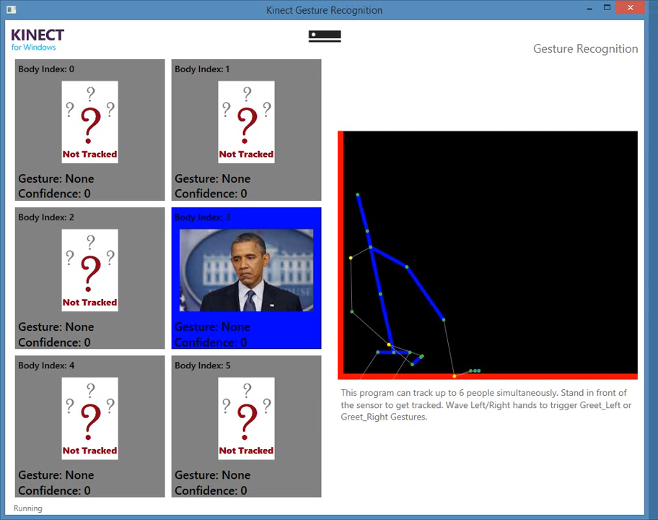
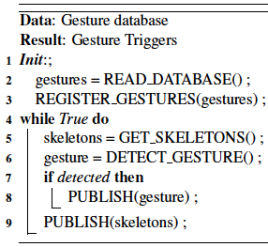
Motion Recognition Module
Kinect Visual Gesture builder work flow
Algorithm
Hand wave discrete gesture
Picture : Microsoft VGB Documentation

Slide 10
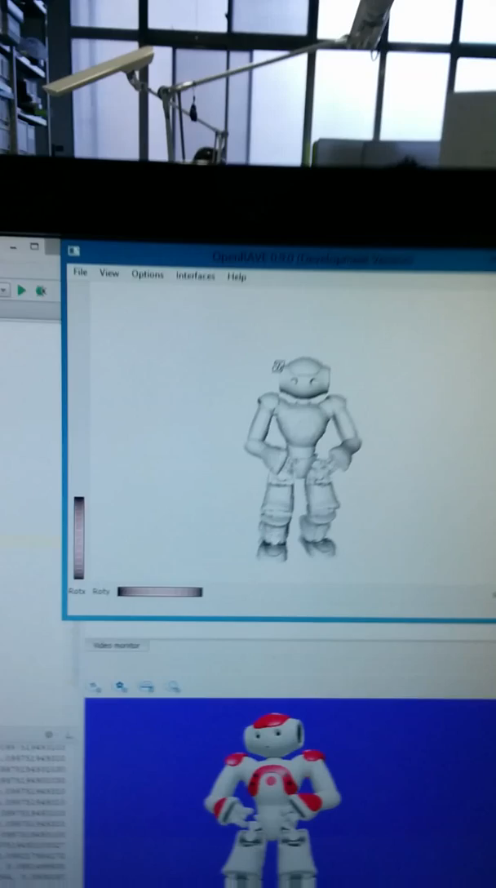
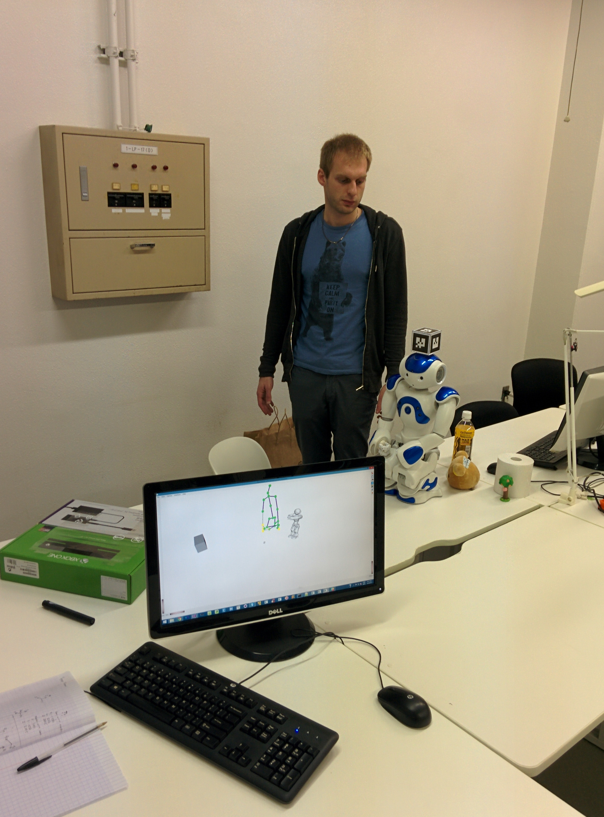
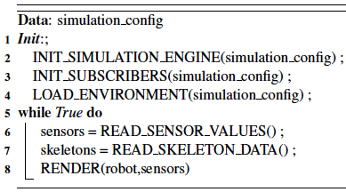
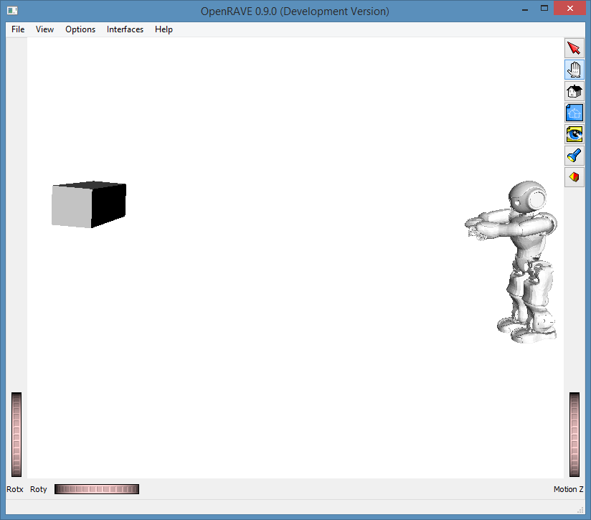
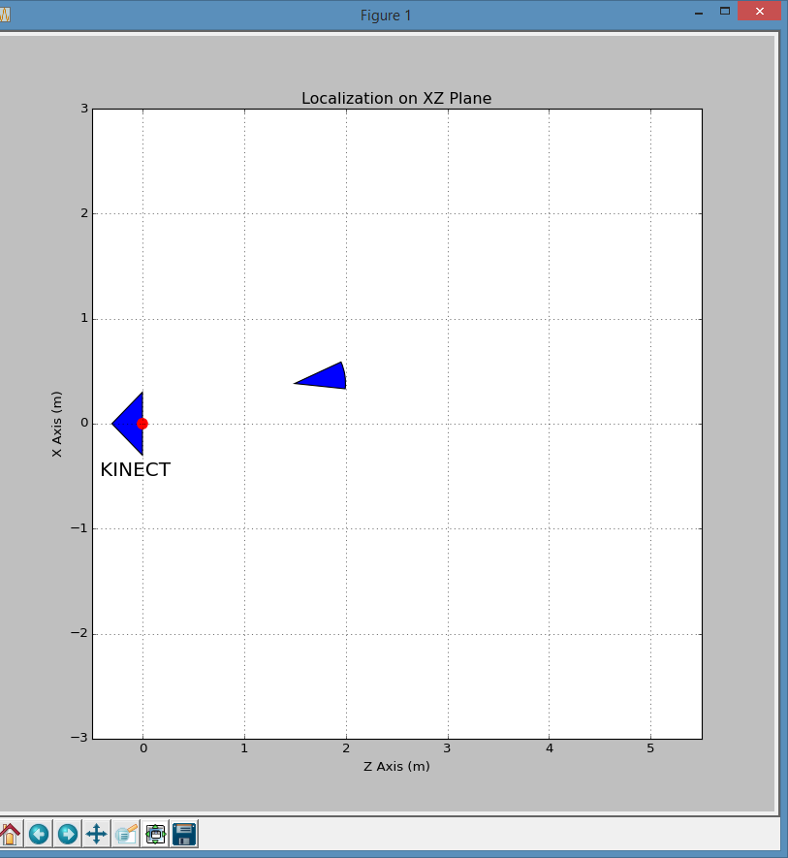
Visualization Module
Algorithm:
KINECT
Localization in XZ Plane
(Top view)
Localization in 3D

Slide 11
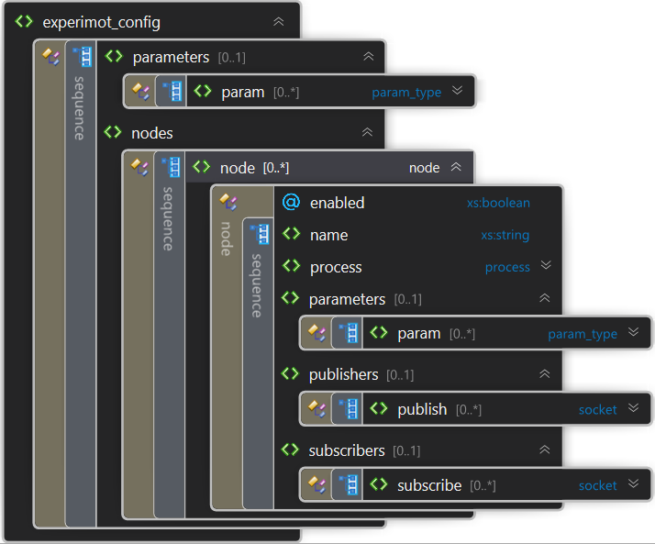
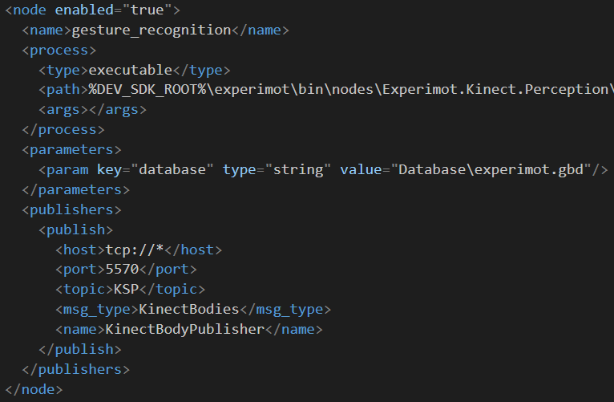
Platform implementation
Configuration Management
Example node configuration

Slide 12
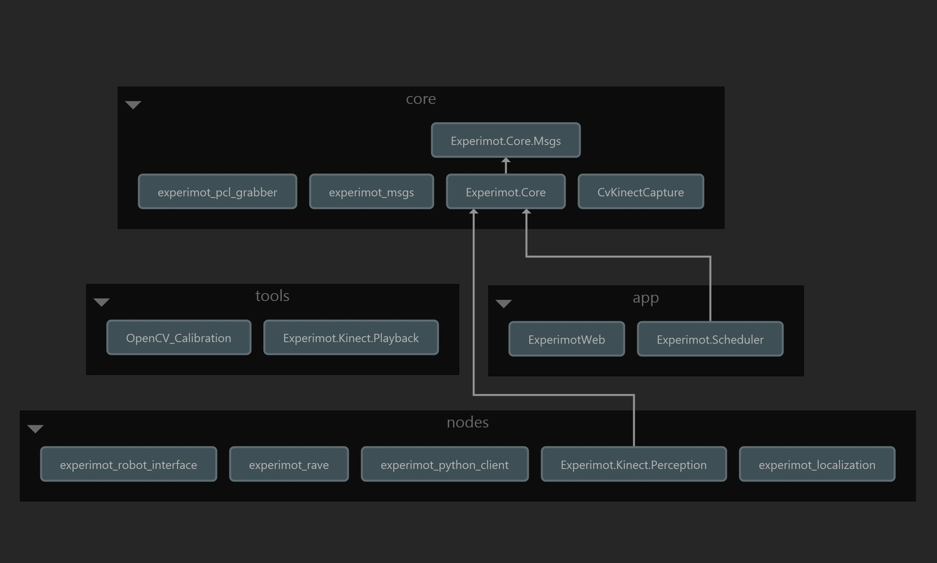
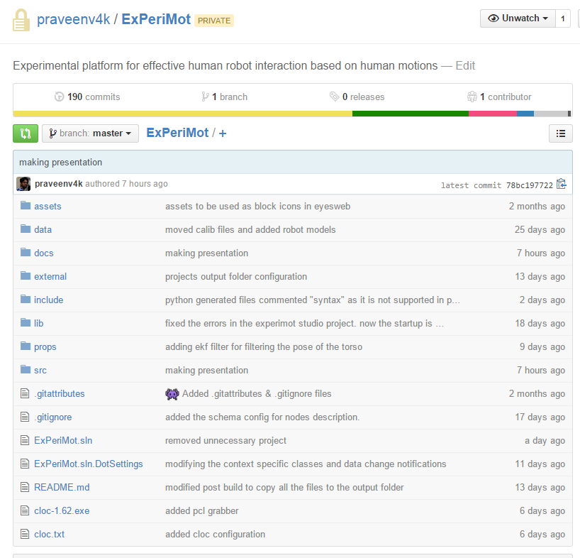
Platform implementation contd.,
Source Code
https://github.com/praveenv4k/ExPeriMot

Slide 13
TO-DO List
Improvement of Pose estimation of marker
Some times the Z-Axis of the detected markers is inward instead of outward
Possible solution: Check the detected frame is right handed/left handed?
Collaborate with Mr. Vincent Berenz to use TDM framework for behavior execution
Improve the data structure that contains the description of the world
Natural Language representation and translation of high level representation into gesture triggers and robot behaviors
Example: “When some one waves hand, respond by waving hands”
Gestures Trigger : Hand waving
Robot behavior : Say hello behavior
Develop an easy to use interface for designing behaviors using high level language
Designing concrete scenarios and evaluate (Receptionist, Something based on IMU?)

Slide 14
Thank you for your attention!

